Slide 1
Presentation on
VSWR meter, Power Meter, S-parameter measurement
By:
Gaurav Topre
(10303320181137210017)

Slide 2
INDEX
WHAT IS VSWR ?
Types of VSWR measurement
What are S-parameters?
Microwave power meter
Sensor Technologies
Type of Microwave Power Meters
References

Slide 3
WHAT IS VSWR ?
VSWR, voltage standing wave ratio is a key parameter to measure when using a radio transmitter, and there are several methods and test instruments that can be used.
As VSWR is a key parameter that is particularly important for applications where transmitters are used.
There are several test instruments and test approaches that can be used to measure VSWR, each with its advantages and disadvantages.
A variety of approaches can be used to measure VSWR using test instruments ranging from VSWR meters to directional power meters, and antenna analyzers to vector network analyzers.

Slide 4
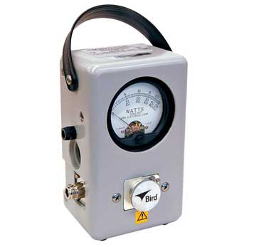
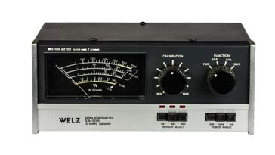
VSWR METER
Fig 1:Typical VSWR meter used with a transmitter
Fig 2: Wattmeter that provides forward and reverse power

Slide 5
Types of VSWR measurement
VSWR measurements using power from transmitter:
These measurements are made using the power supplied by a transmitter. Typically they are made with a transmitter operating with a reasonable level of power. The VSWR meters used are often left in line during normal operation as a monitor of current readings. In this way they can provide a very useful indication of a fault occurring, or a rise in VSWR due to another issue during operation.
Test instrument stimulus VSWR measurements:
Other tests are achieved using test instruments that supply a (typically) low power stimulus to the load or system. These VSWR measurements and tests are normally done during set-up or development and then only as required. They cannot be left in circuit during normal operation as they cannot operate with the transmitter in situ and providing its power.

Slide 6
What are S-parameters?
S-parameters are complex matrix that show Reflection/Transmission characteristics (Amplitude/Phase) in frequency domain.
S-parameters are complex matrix that show Reflection/Transmission characteristics (Amplitude/Phase) in frequency domain. This type of test equipment is called “Stimulus/Response” and applies to both Vector Network Analyzers (VNA) and Time Domain Reflectometers (TDR).
A two-port device has four S-parameters. The numbering convention for S-parameters is that the first number following the “S” is the port where the signal emerges, and the second number is the port where the signal is applied. So S21 is a measure of the signal coming out port 2 relative to the RF stimulus entering port 1. When the numbers are the same (e.g., S11), in indicates a reflection measurement, as the input and output ports are the same.

Slide 7
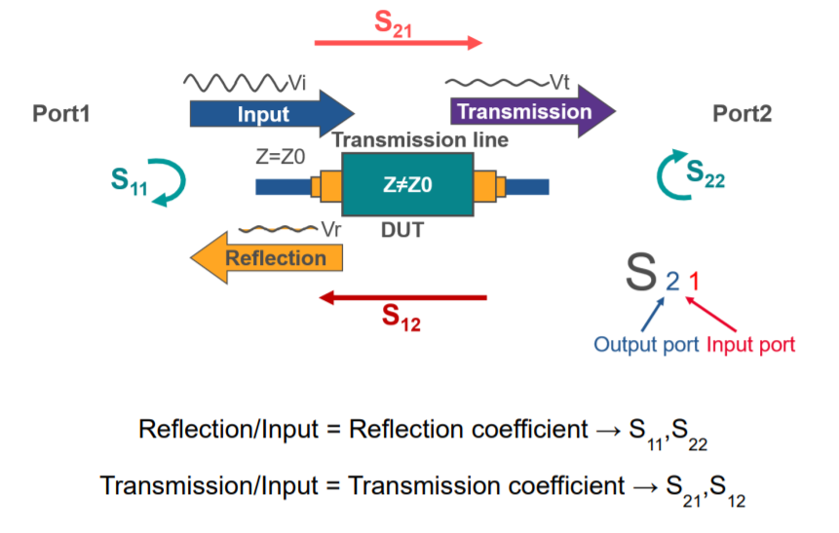
Representation

Slide 8
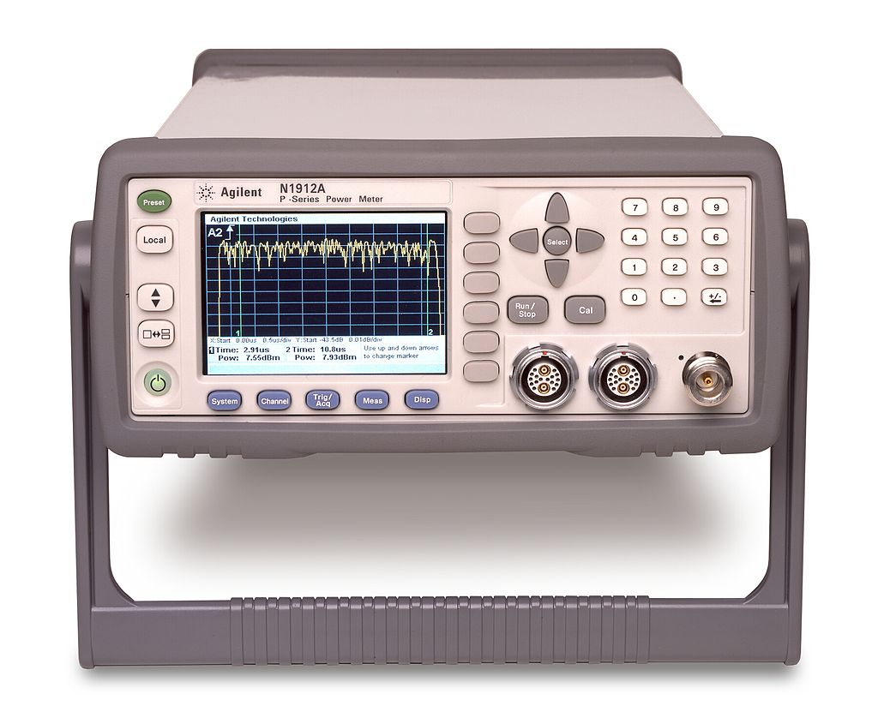
Microwave power meter
A microwave power meter is an instrument which measures the electrical power at microwave frequencies typically in the range 100 MHz to 40 GHz.
Microwave power meters have a wide bandwidth—they are not frequency-selective. To measure the power of a specific frequency component in the presence of other signals at different frequencies a spectrum analyzer or measuring receiver is needed.
Fig 3: Agilent P-series Power Meter

Slide 9
Sensor Technologies
There are a variety of different technologies which have been used as the power sensing element.
Thermal
Thermal sensors can generally be divided into two main categories, thermocouple power sensors and thermistor-based power sensors. Thermal sensors depend on the process of absorbing the RF and microwave signal energy, and sense the resulting heat rise.
Diode
Many microwave power heads use diodes to rectify the incident microwave power, and have extremely fast response. The diode would generally be used in its square-law region and hence give an output voltage proportional to the incident RF power.
Field strength
Other technologies have been investigated or implemented for use as power sensors but are not widely used today; these include torque-vane, electron-beam, MEMS, Hall effect and atomic fountain based sensors.

Slide 10
Type of Microwave Power Meters
The two main types of microwave power meters are:
Average power meter –
measures true average power of the signal and displays the power much like a digital voltmeter
Peak and average power meter –
has the feel of an oscilloscope. It displays profile or envelope power of the signal versus time and can make triggered measurements. In addition to peak, average and peak-to-average power measurements, high end models can make automated pulse measurements of a pulsed RF signal such as pulse average power, risetime and fall time, pulse width, duty cycle, pulse repetition rate, overshoot, droop, edge delay measurements. It can also make marker measurements as well.

Slide 11
References
"Principles of Power Measurement Guide". Boonton. Boonton. Retrieved November 1, 2018.
"First Microwave Power Meter". HPMemory. HPMemory. Retrieved November 1, 2018.
"4 Steps for Making Better Power Measurements" . Keysight. Keysight. Retrieved November 1, 2018.
"Fundamentals of RF and Microwave Power Measurements (Part 2)" . Keysight. Keysight. Retrieved November 1, 2018.

